Slide 1
Atlas Platform
AngularJS Case Study

Slide 2
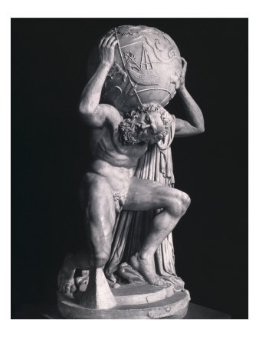
So, what is ‘Atlas’ Anyway ?

Slide 3
So, what is ‘Atlas’ Anyway ?
App A
App B
App C
App D
ATLAS PLATFORM
Authentication
Data Access
Authorisation
Configuration
Preferences
Layout
Navigation
SPA Back Button Support
Session Management

Slide 4
Atlas from 10,000ft
AIM
Container
Configuration
Platform Services
Helix
Feature X
Helix
Mission Control
Data
Feature Server (IIS)
REST APIs
Middleware

Slide 5
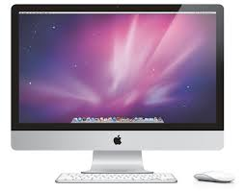

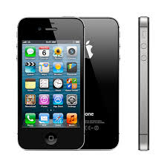
WORA
The nirvana of contemporary application development
Write Once, Run Anywhere
App X
App X
App X

Slide 6
My ASB
Pilot deployment of ATLAS
Primordial version of what will eventually replace FNC
Staff Alpha release just launched

Slide 7
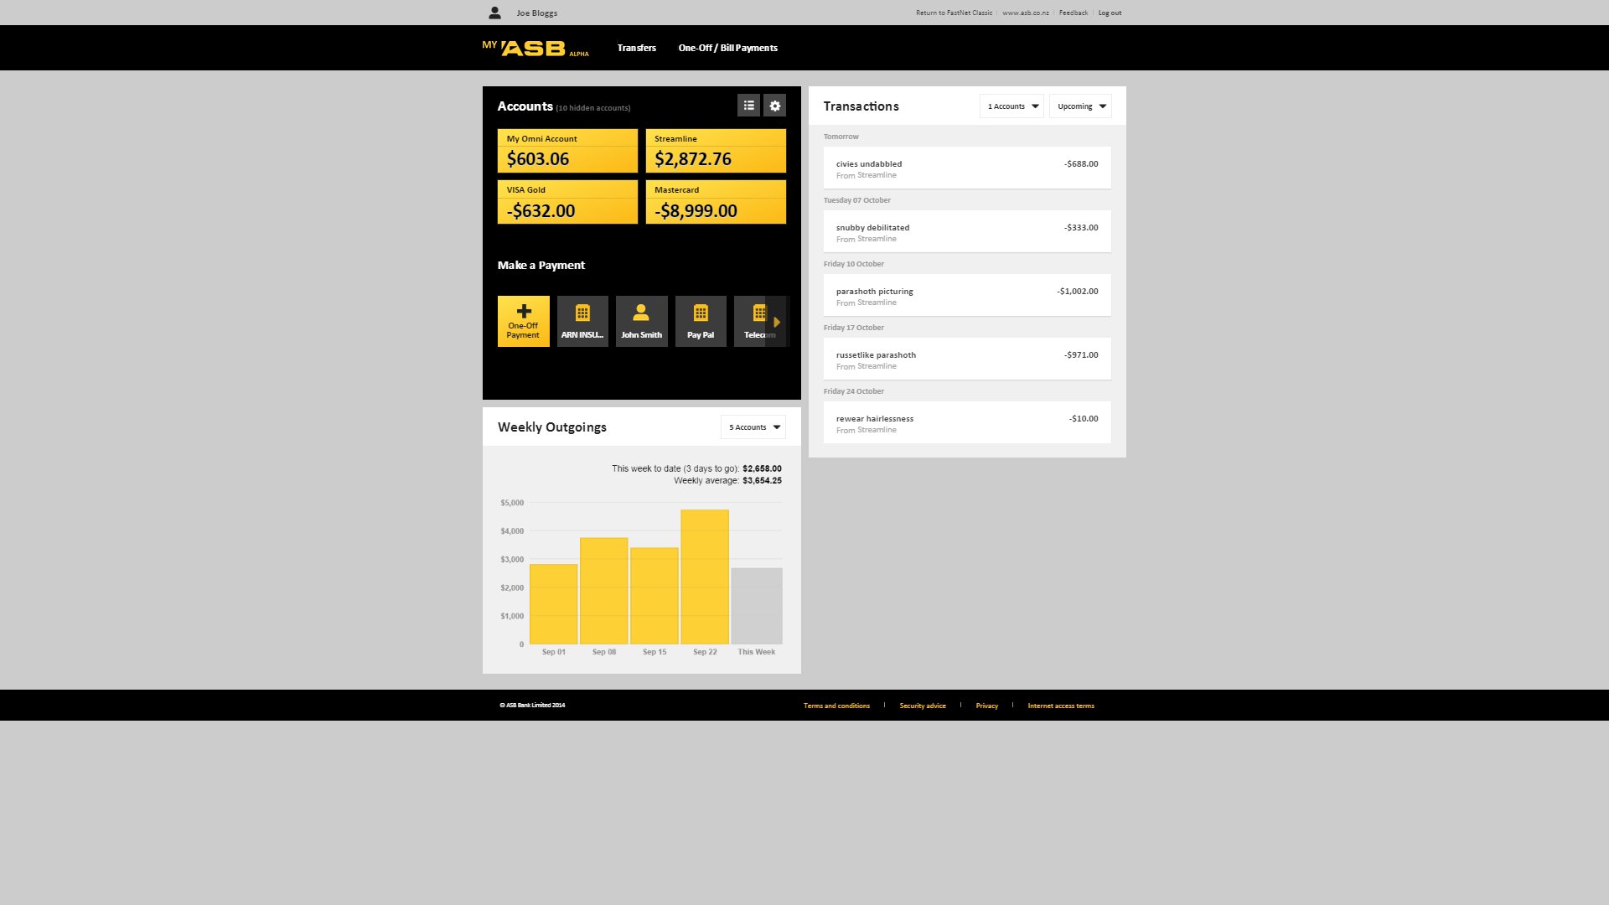
Container
Feature
Feature
Feature

Slide 8
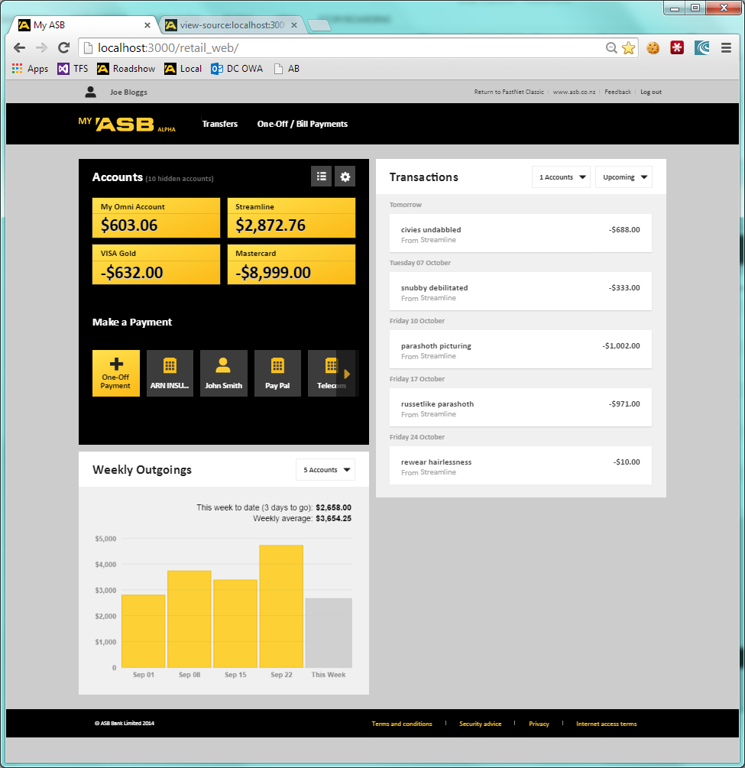

Slide 9
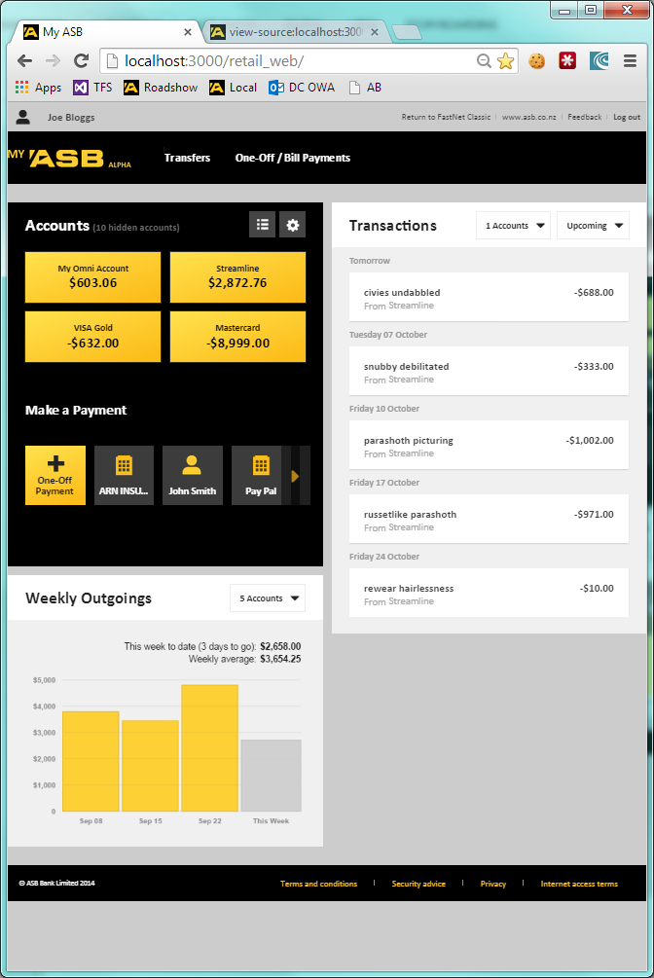

Slide 10
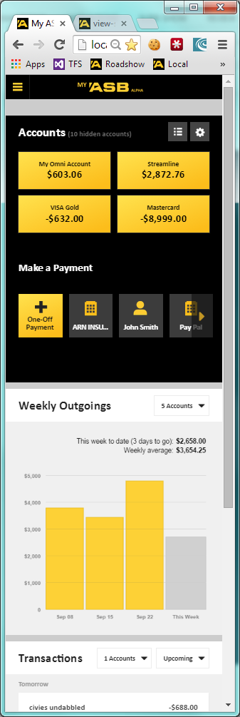

Slide 11
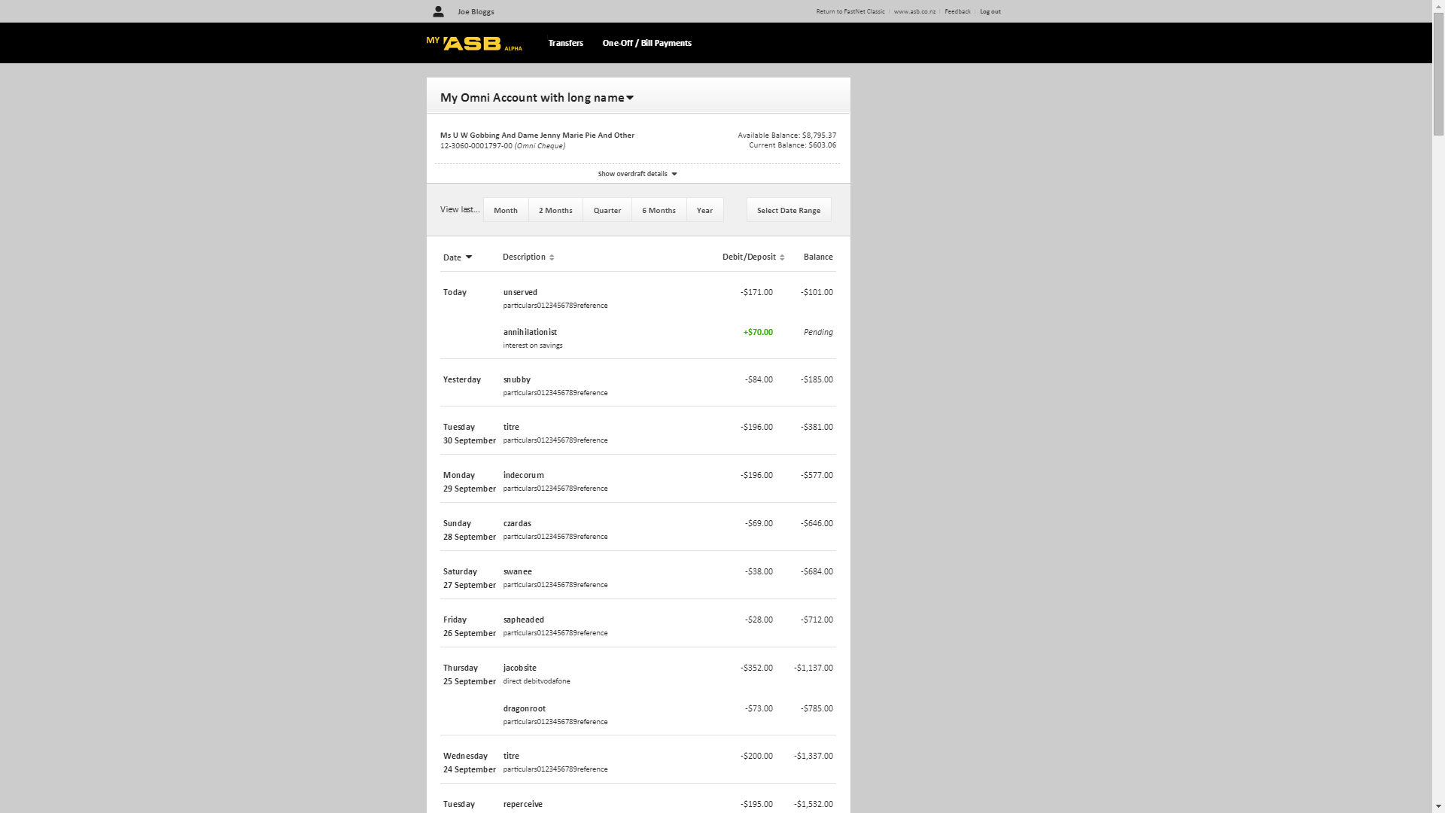

Slide 12
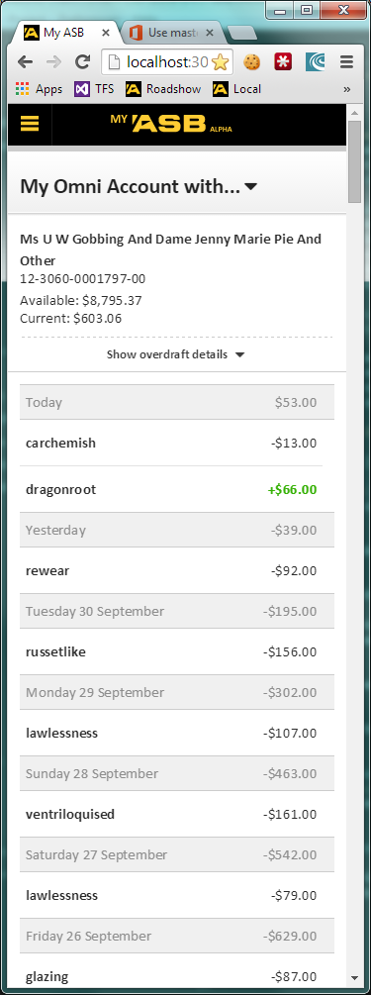

Slide 13
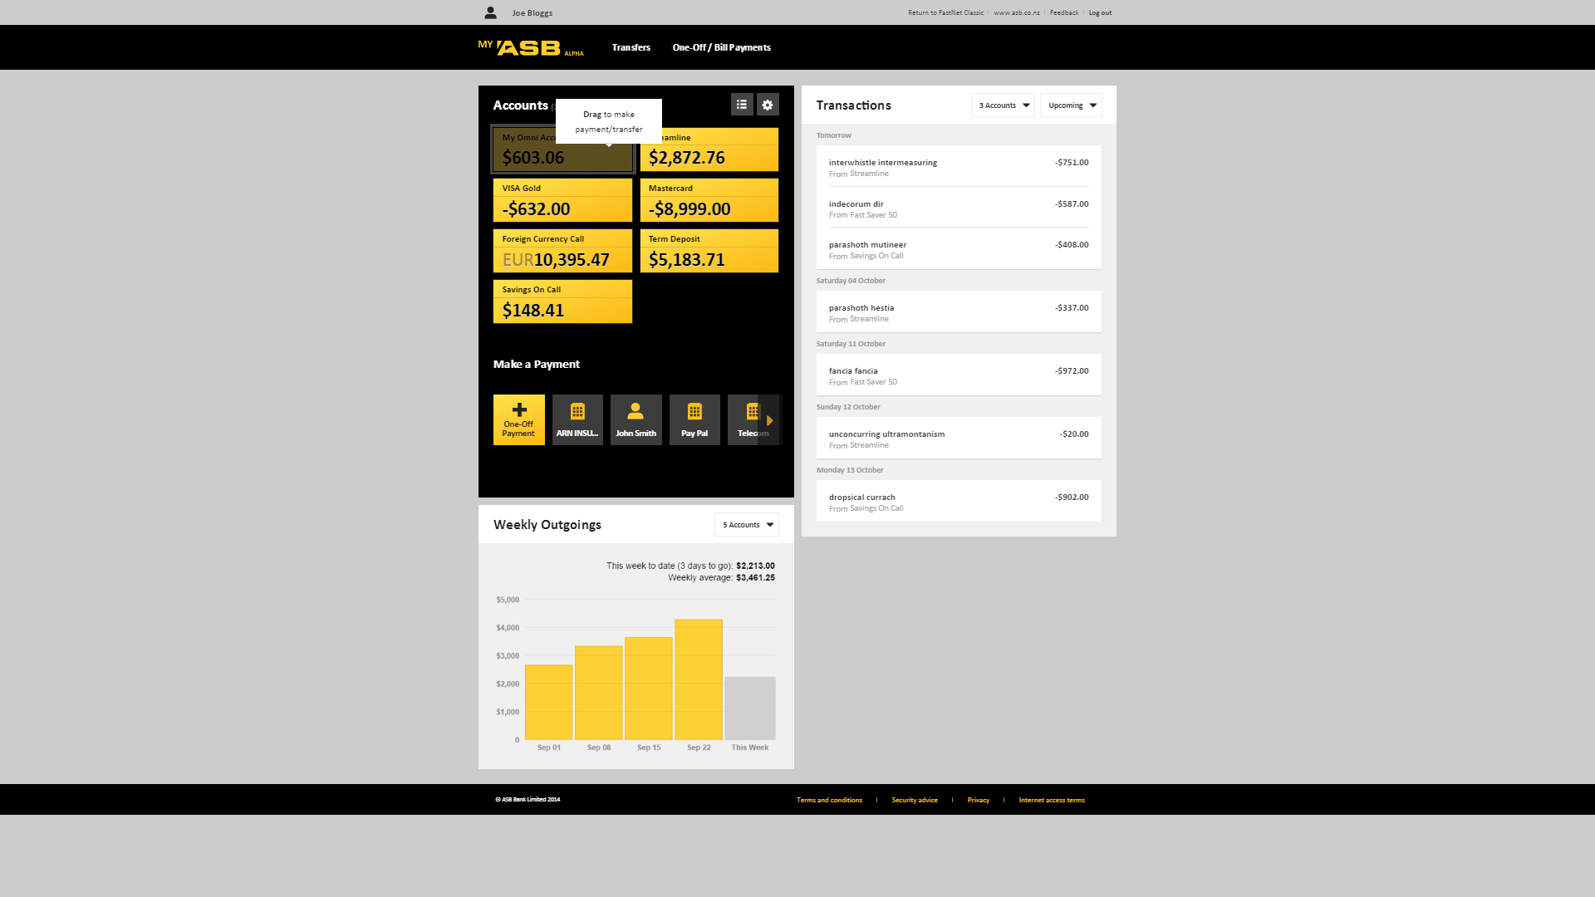

Slide 14
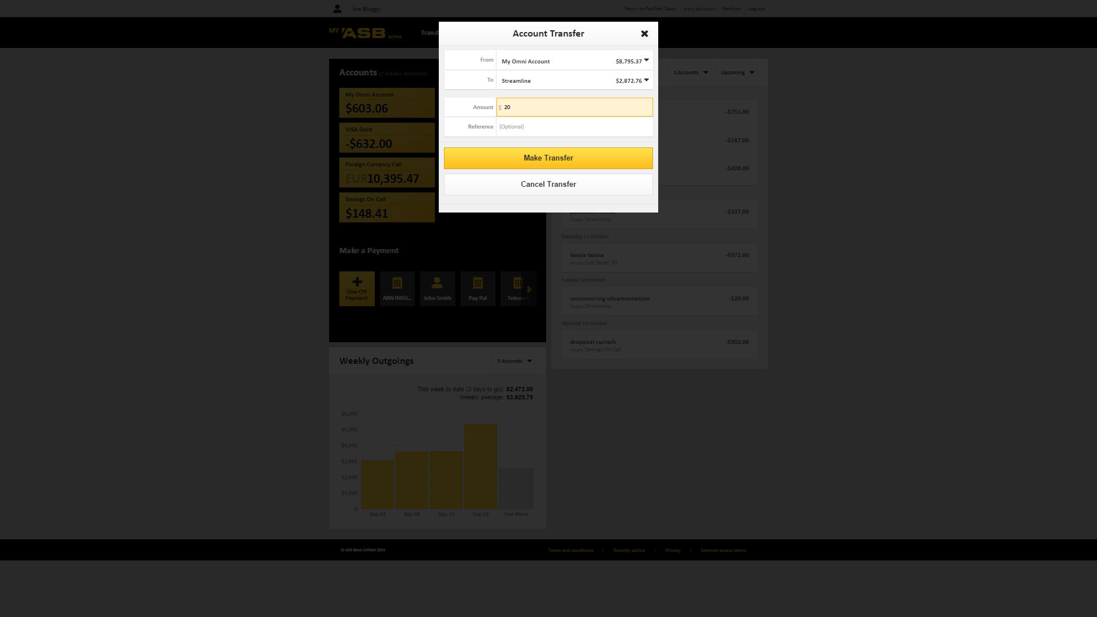

Slide 15
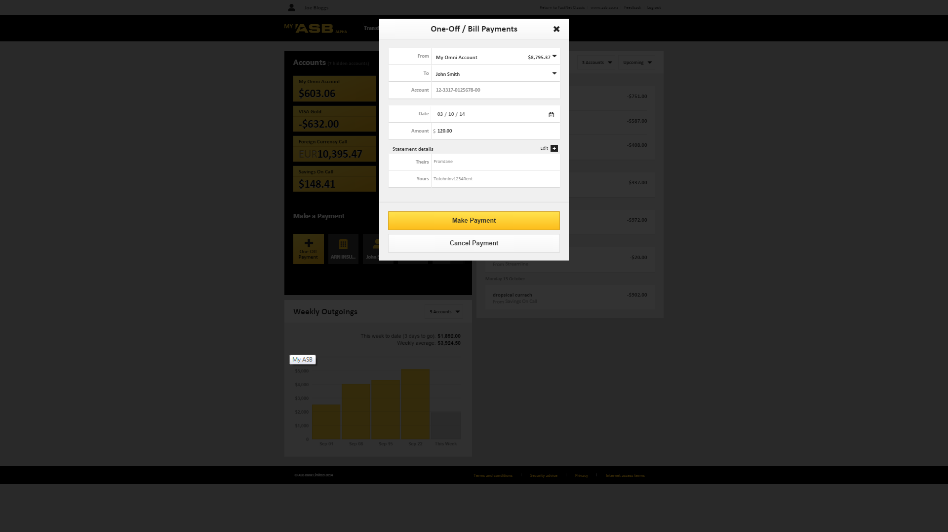

Slide 16
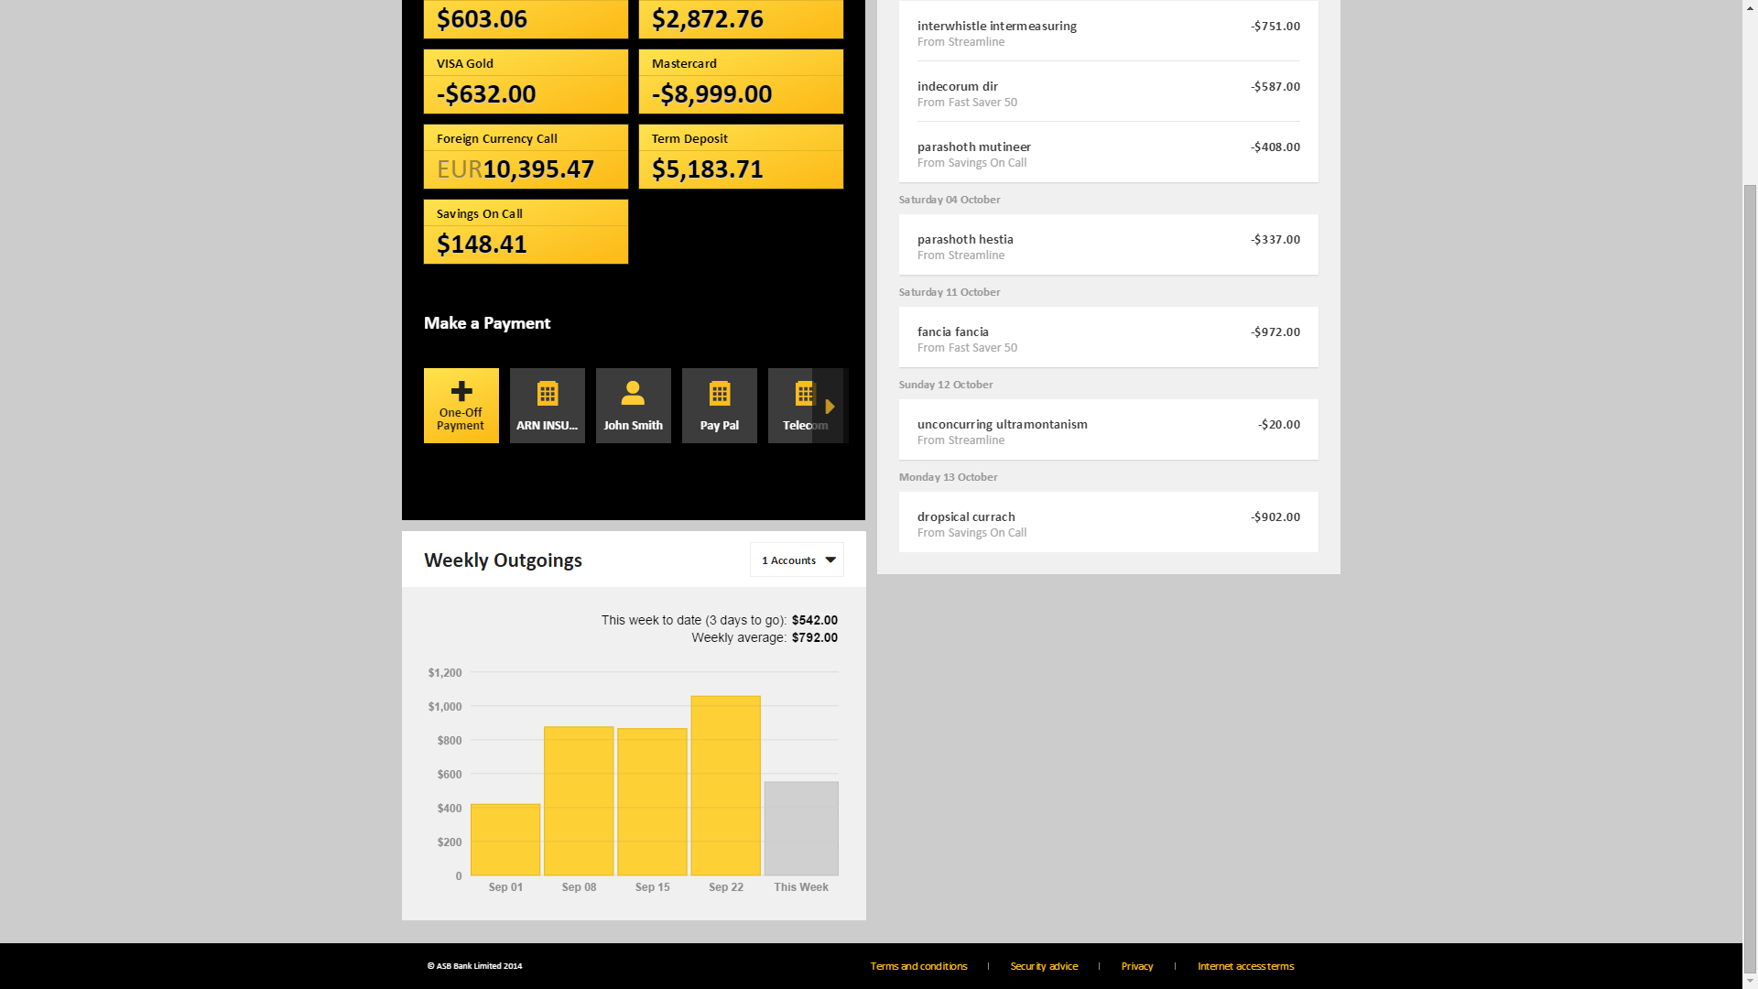

Slide 17
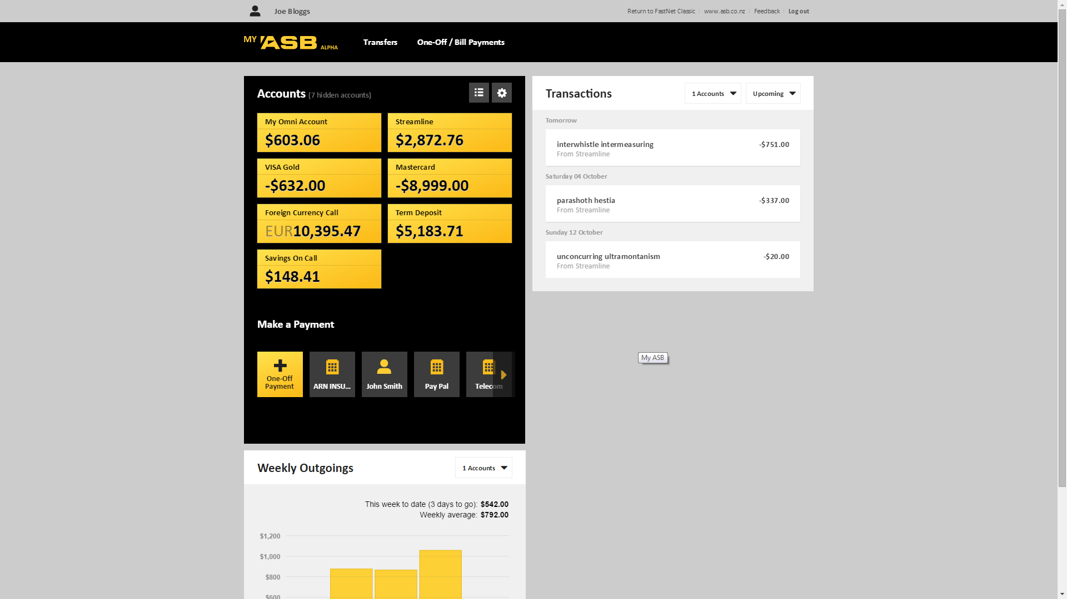

Slide 18
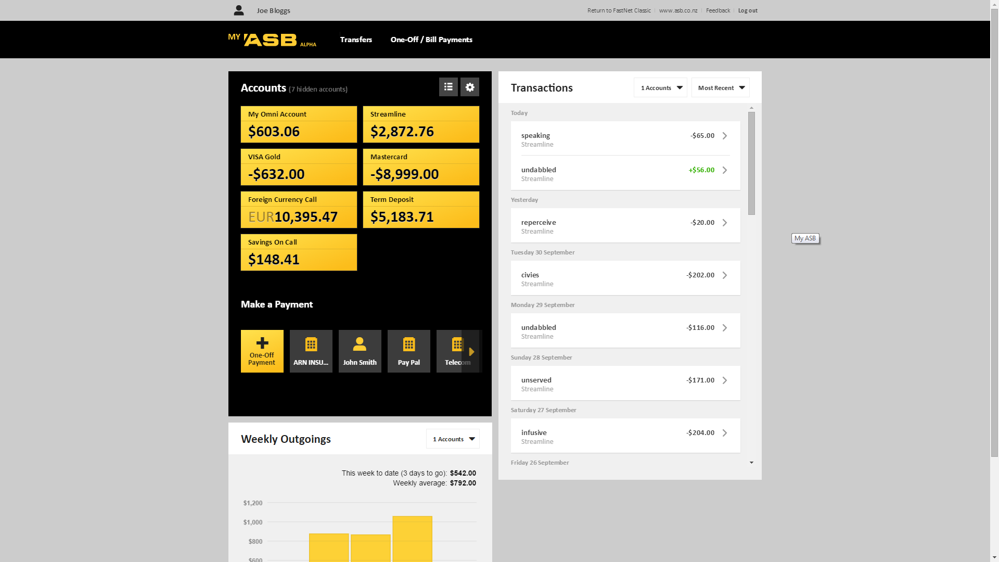

Slide 20




My ASB Technology Stack
ASB.Helix
CBA.Helix
Service Layer
Controllers

Slide 21
AngularJS Responsibilities
VIEW
Filters
Model ($scope)
Directives
Controller
Controller
Controller
Services

Slide 22
Service Layer
Balances
Controller
Transactions
Controller
Transfer
Controller
Payments
Controller
Infographics
Controller
My Transactions
Controller
Public Holidays Svc
Payments Svc
Account Svc
Transactions Svc
Transfer Svc
Payees Svc
Feature Svc
Helix
REST
API
/accounts

Slide 23





Other Tools
Grunt
Foundation
Build Tasks
CSS pre-processing
Responsive Layout
Module Loading

Slide 25
HTML 5
The Hitchhikers Guide to

Slide 26
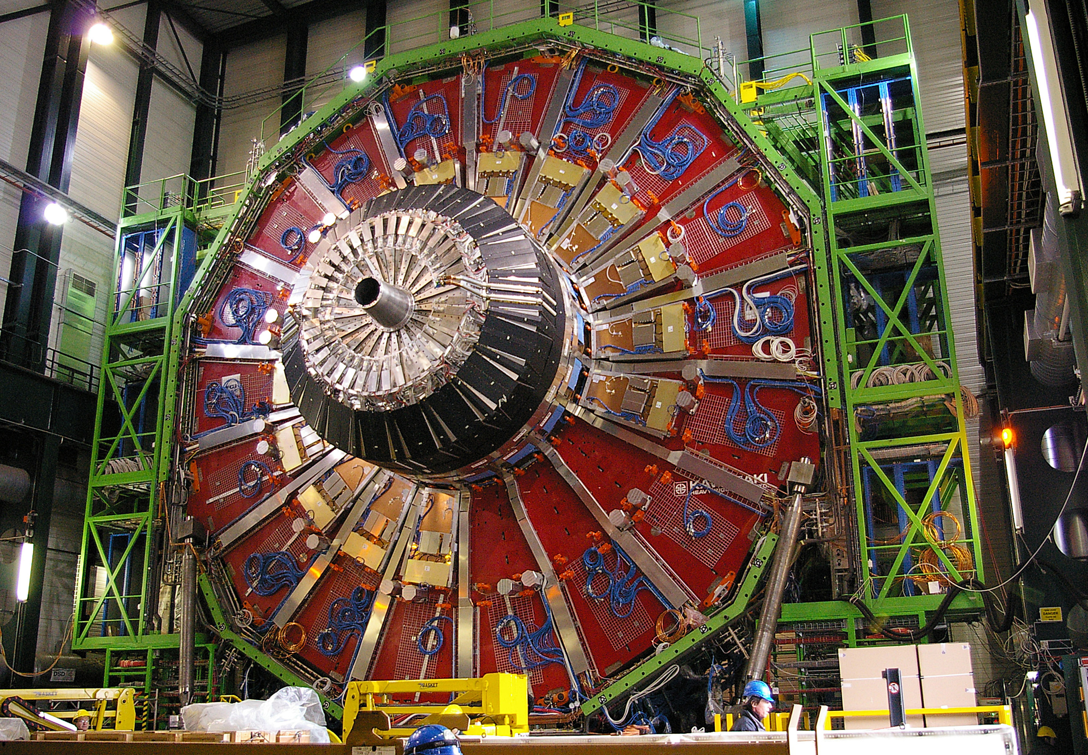

Slide 27
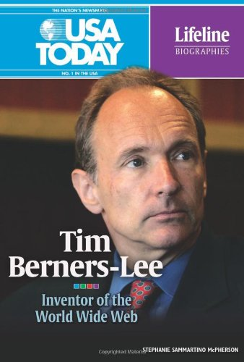
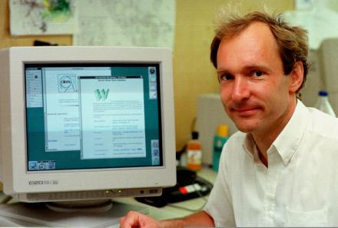
Tim Berners-Lee
Computer Science degree from Queens College, Oxford
Built his first computer from spare parts using a soldering iron and an old television

Slide 28
1980
Tim Berners-Lee joins CERN as software consultant
Writes ‘Enquire’ to keep track of ‘random associations’

Slide 29
1980 - 1989
“So the data was there, somewhere, going around and around on a disk, but it was really difficult to get at”
“So there I had the Internet, I had the problem, I had all the tools, I just needed to be given some spare time to do it”

Slide 30
1990
Writes early draft specifications for HTML, URI, HTTP
Builds first HTTPd server and client (‘WorldWideWeb’) using NeXT computer and Objective-C

Slide 31
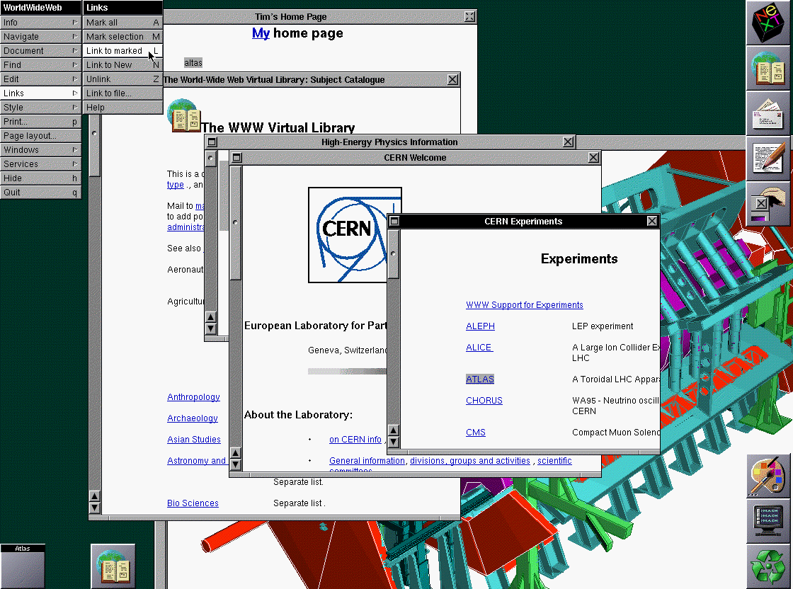

Slide 32
1991
www-talk mailing list created to foster open discussions about HTML and the www

Slide 33
Date: Mon, 28 Oct 91 14:34:12 GMT+0100
From: timbl (Tim Berners-Lee)
Message-Id: <9110281334.AA06863@ nxoc01.cern.ch >
To: www-talk
Subject: test again!
If you get this, delete it. - Sorry!

Slide 34
Date: Mon, 28 Oct 91 16:33:14 GMT+0100
From: timbl (Tim Berners-Lee)
Message-Id: <9110281533.AA06989@ nxoc01.cern.ch >
To: www-interest@nxoc01.cern.ch
Subject: WorldWideWeb mailing list: Introduction
We have (at last!) started the www-interest mailing list. Your name
is, for one reason or another, on it. The list is a list for
announcements about the World Wide Web (W3) distributed information
system, mainly about
o New online information available
o New W3 software releases
If you do not want to be on this list, please accept our apologies
and mail listserv@info.cern.ch with the message body
delete www-interest
If others wish to subscribe to this list, they should mail
listserv@info.cern.ch with the message body
add www-interest
There is a similar list, called www-talk, for developers of W3
software. Members of www-talk get www-interest automatically.
If you have any queries for a human response, mail
www-interest-request@info.cern.ch.
Tim BL
__________________________________________________________
Tim Berners-Lee timbl@info.cern.ch
World Wide Web project (NeXTMail is ok)
CERN Tel: +41(22)767 3755
1211 Geneva 23, Switzerland Fax: +41(22)767 7155

Slide 35
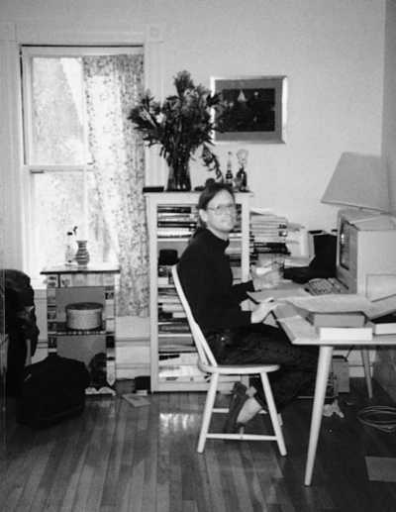
1991
Dave Raggett (Hewlett-Packard, Bristol, England) collaborates with TBL
Initiates work on HTML+ specification
Later develops web browser called Arena

Slide 36
1992
NCSA take an interest in the www
Marc Andreessen and Eric Bina start work on a new browser called Mosiac

Slide 37
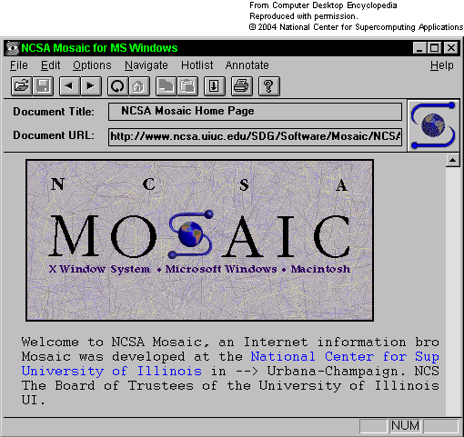
1993

Slide 38
1994
Inaugural www conference (Geneva)
IEFT forms HTML WG
HTML 2.0 specification released (TBL, Dan Connolly)
Netscape formed (Marc Andreessen)
W3C formed (MIT, INRIA, Keio University)

Slide 39
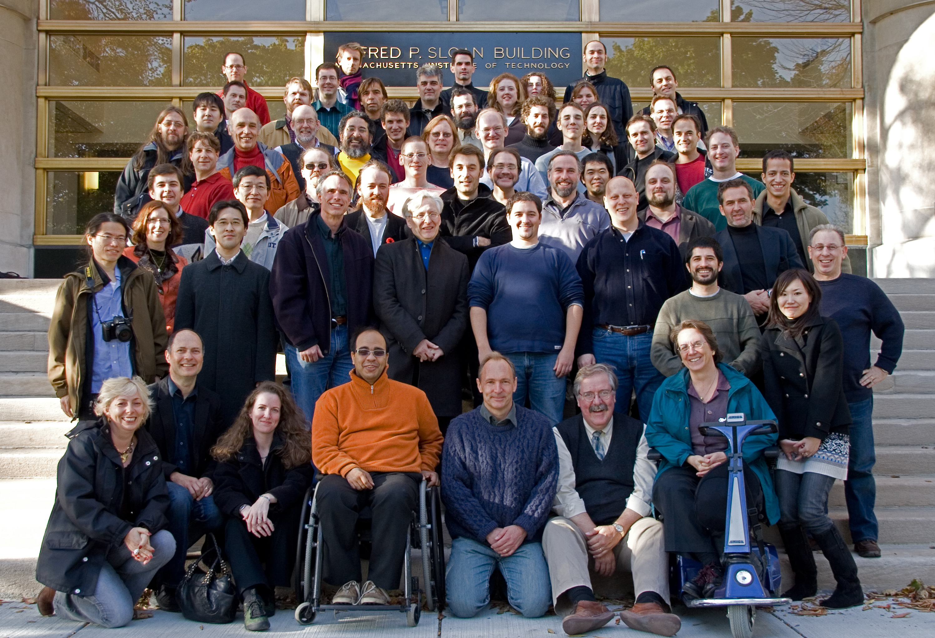
W3C

Slide 40
1995
HTML 3.0 draft (nee HTML+) rejected by IETF
Internet Explorer released
CSS draft specification
Brendan Eich (Netscape) creates JavaScript in 10 days

Slide 41
IE
HTML spec
Netscape
xyz

Slide 42
1996
HTML Editorial Review Board established (IBM, Microsoft, Netscape, W3C)
Netscape agreed to remove <BLINK>…
…but only if Microsoft removed <MARQUEE>

Slide 43
1997
HTML 3.2 endorsed
HTML 4.0 released

Slide 44
1998
W3C announces the end of HTML, in favour of XHTML

Slide 45
2000
XHTML 1.0 specification (HTML 4.0 as xml)

Slide 46
2001
XHTML 1.1 (strict) specification
Work commences on XHTML 2.0

Slide 47
2004
Web Forms 2.0 proposal (Mozilla, Opera, et al)
Rejected by W3C
WHATWG established as break-away venue for evolving HTML

Slide 48



WHATWG
Web Hypertext Application Technology Working Group
“Web technologies needed to be backwards compatible”
Specifications and implementations needed to match, even if this meant changing the specification rather than the implementation

Slide 49
WHATWG
Web Applications 1.0
Web Forms 2.0
Web Controls 1.0

Slide 50

W3C
WHAT-WG
1990
HTML 1.0
HTML 2.0
HTML 3.2
1997
HTML 4.0
XHTML 1.0
XHTML 1.1
2004
XHTML 2.0
Web Apps 1.0
Web Forms 2.0
Web Controls 1.0

Slide 51
2006
W3C realises future of web not XHTML after all
Request collaboration with WHATWG efforts in evolving HTML
Web Apps 1.0 specification renamed HTML5

Slide 52



W3C
WHATWG
HTML WG
2004
XHTML 2.0
Web Apps WG
Web Apps 1.0
Web Forms 2.0
Web Controls 1.0
2006
HTML 5.0
Web Apps 1.0
Web Forms 2.0
Web Controls 1.0
HTML 5.0
HTML5
HTML5
HTML5
HTML 5.0
HTML5
HTML5

Slide 53
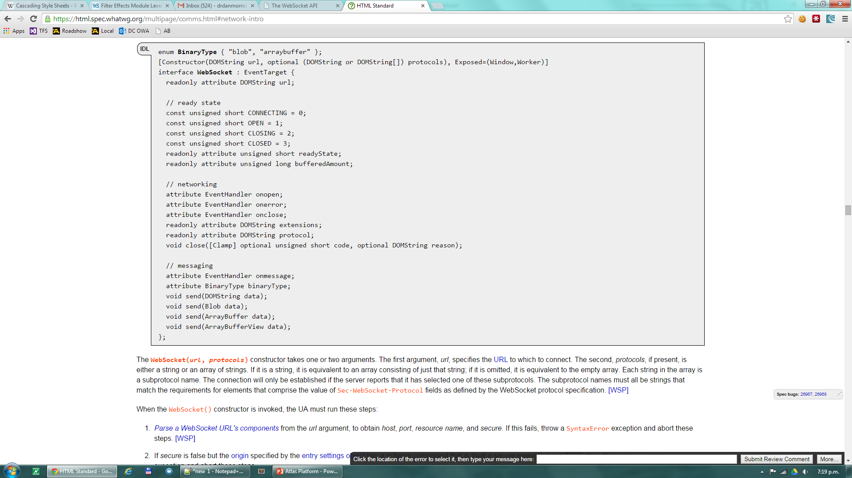

Slide 54
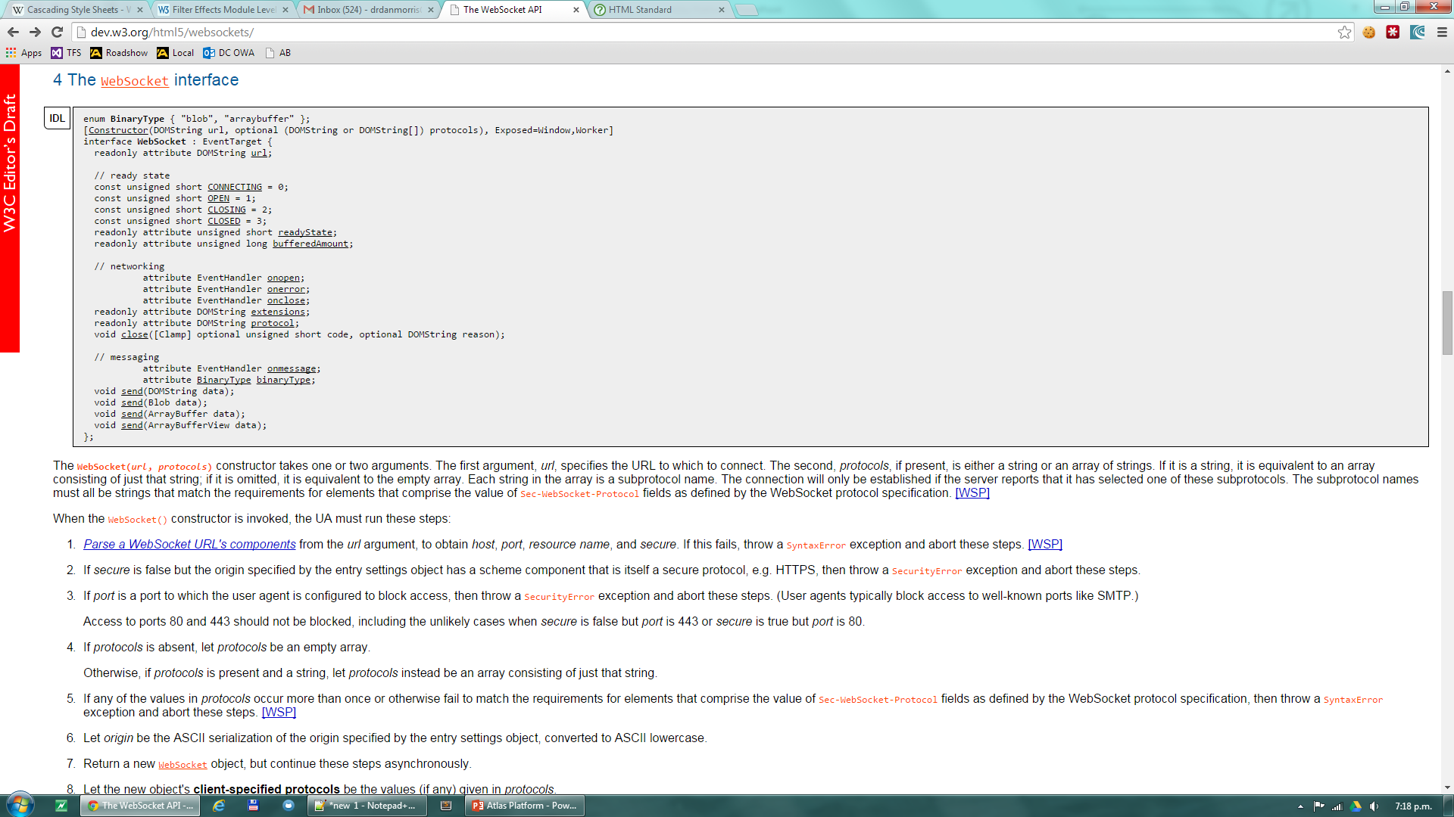

Slide 55
W3C
WHATWG
HTML WG
2004
XHTML 2.0
Web Apps WG
Web Apps 1.0
Web Forms 2.0
Web Controls 1.0
2006
HTML 5.0
Web Apps 1.0
Web Forms 2.0
Web Controls 1.0
HTML 5.0
HTML5
2009
Last Call
HTML5
2012
Candidate
Recommendation
HTML5
Bug-free spec
HTML 5.0
HTML5
Two reference implementations
HTML5
20,000+ unit tests
?
2022
Recommendation
HTML5

Slide 56
W3C Specification Lifecycle
Working Draft
Last Call
Candidate Recommendation
Proposed Recommendation
W3C Recommendation

Slide 57
WHATWG Specification Lifecycle
Idea
First Draft
Working Draft
Last Call for Comments
Awaiting Implementation Feedback
Implemented and Widely Deployed

Slide 58
2011
Apparent that ideologies of W3C and WHATWG were fundamentally apposed
W3C – wanted to finalise HTML5
WHATWG – wanted to continue to evolve HTML as a Living Specification

Slide 59
W3C
WHATWG
HTML WG
2004
XHTML 2.0
Web Apps WG
Web Apps 1.0
Web Forms 2.0
Web Controls 1.0
2006
HTML 5.0
Web Apps 1.0
Web Forms 2.0
Web Controls 1.0
HTML 5.0
HTML5
HTML5
HTML5
HTML5
HTML5
HTML5
HTML5
2011
HTML 5.0
HTML ‘Living Specification’

Slide 60
“The W3C also publishes parts of this specification as separate documents that are forked subsets of the HTML Living Standard. There are numerous differences between the HTML Living Standard and the W3C forks; some minor, some major. Unfortunately these are not currently accurately documented anywhere, so there is no way to know which are intentional and which are not.”
WHATWG
HTML: The Living Standard

Slide 61
W3C HTML WG
FPWD
LC
CR
PR
REC
N/A
2011 Q2
2012 Q2
2014 Q1
2014 Q2

Slide 62
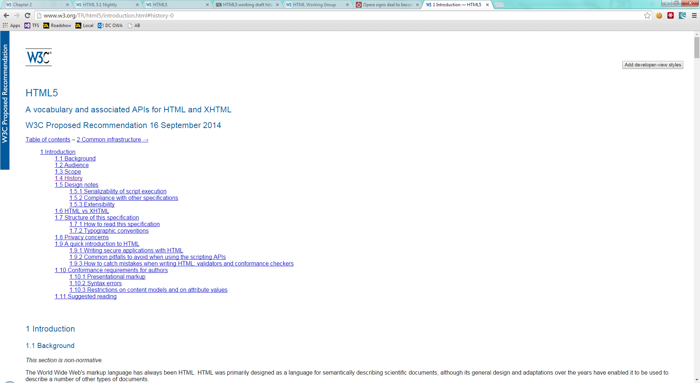

Slide 63
W3C HTML WG
Spec
FPWD
LC
CR
PR
REC
HTML5
N/A
2011 Q2
2012 Q2
2014 Q4
2014 Q4
HTML5.1
2012 Q4
2014 Q3
2015 Q1
2016 Q4
2016 Q4

Slide 64
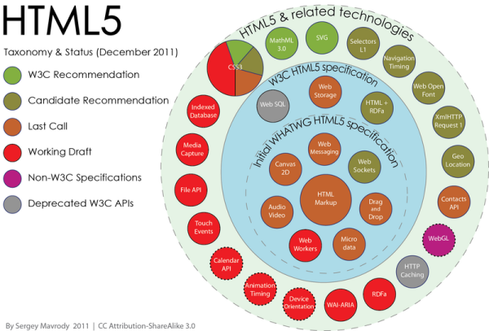
REC
REC
REC
REC
CR
REC
CR
WD
CR
CR
CR
CR
REC
WD
?
?
WD
REC
GN
?
?
WD
REC
WD

Slide 65
More Information ?
W3C – HTML5 specification
WHATWG – Living HTML specification

Slide 66
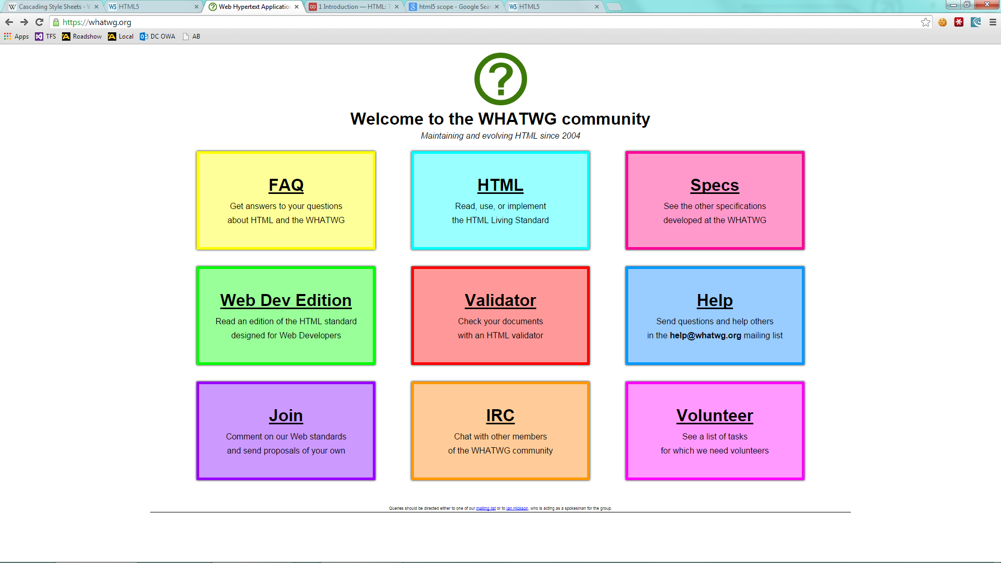

Slide 67
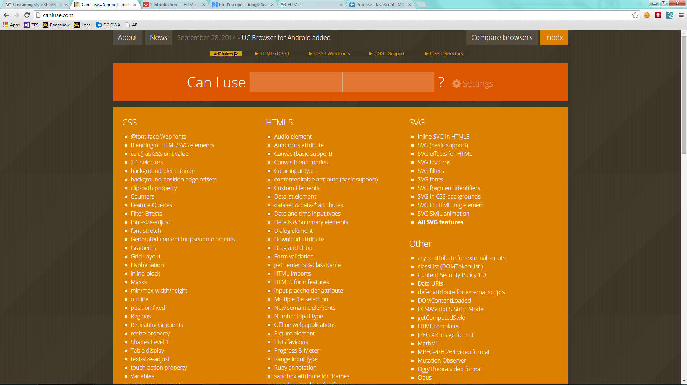

Slide 68
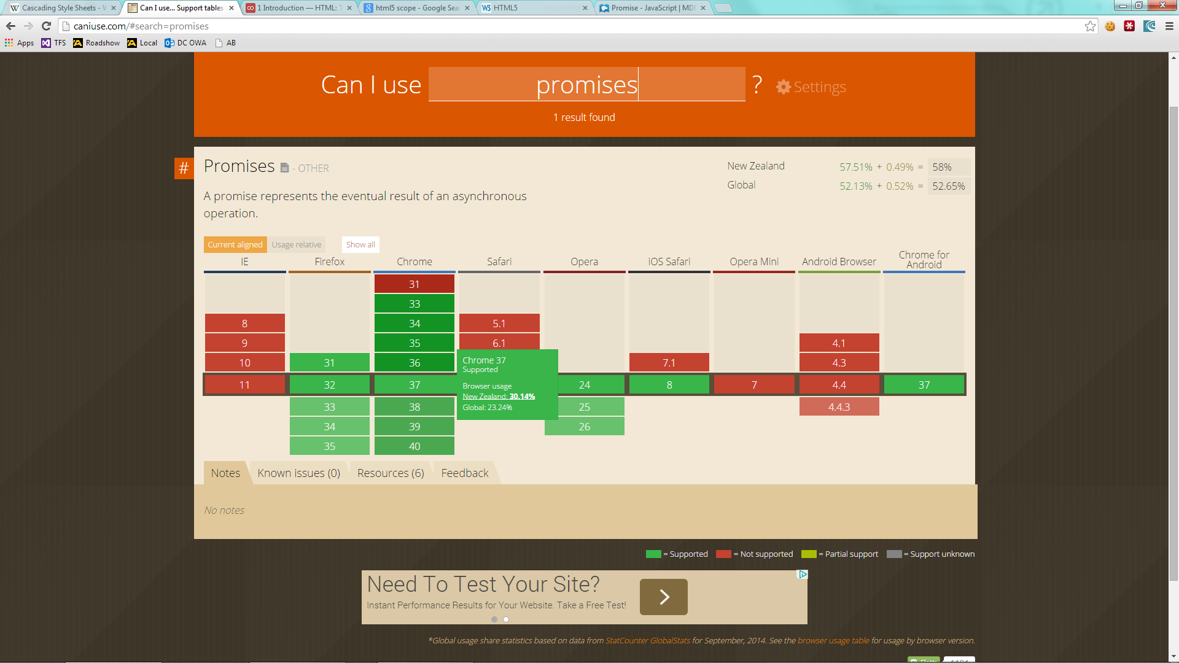

Slide 69
So, what about JavaScript ?
Technically not part of HTML5
APIs that JavaScript consumes are part of HTML5
JavaScript is an implementation of EcmaScript, currently 5.1

Slide 70
1990
1992
1994
1996
1998
2000
2002
2004
2006
2008
HTML1
HTML2
HTML3.2
Ecma
Script 3.1
Ecma
Script 5
Mocha
HTML4
jQuery
LiveScript
Ecma
Script 1
JavaScript
Ecma
Script 2
2014
2016
2010
2012
CSS1
Ecma
Script 3
Common
JS
HTML
HTML5
CSS2
Backbone
AngularJS
?
Ecma
Script 5.1
Ecma
Script 6
Knockout
CSS2.1
50+ CSS3 Modules

Slide 71
